Slide 1
STUDY 1
1
2
3
Logo
Logo
Choose: User Gender
Choose: Agent Gender
Agent
Introduction:
xxx.
xxx.
[Click here to begin]
Variable: can be male or female
Agent
Chat bubbles
Variable: can be male or female
Variable: can be male or female (CONSISTENT with Agent gender)
Non-variable: only use neutral script

Slide 2
STUDY 2
1
2
3
Logo
Logo
Choose: User Gender
Choose: Agent Gender
Variable: can be male or female
Agent
Introduction:
xxx.
xxx.
[Click here to begin]
Variable: can be male or female
Agent
Chat bubbles
Choose: Script Gender
Variable: can be male or female (CONSISTENT with Agent gender)
Variable: can be male or female (INDEPENDENT of Agent gender)

Slide 3
ONLINE PILOT STUDY
1
2
3
Randomization of conditions (not shown to respondents)
Logo
Logo
Introduction:
xxx.
xxx.
[Click here to begin]
Chat bubbles
Variable: can be male or female
Non-variable: only use neutral script

Slide 4
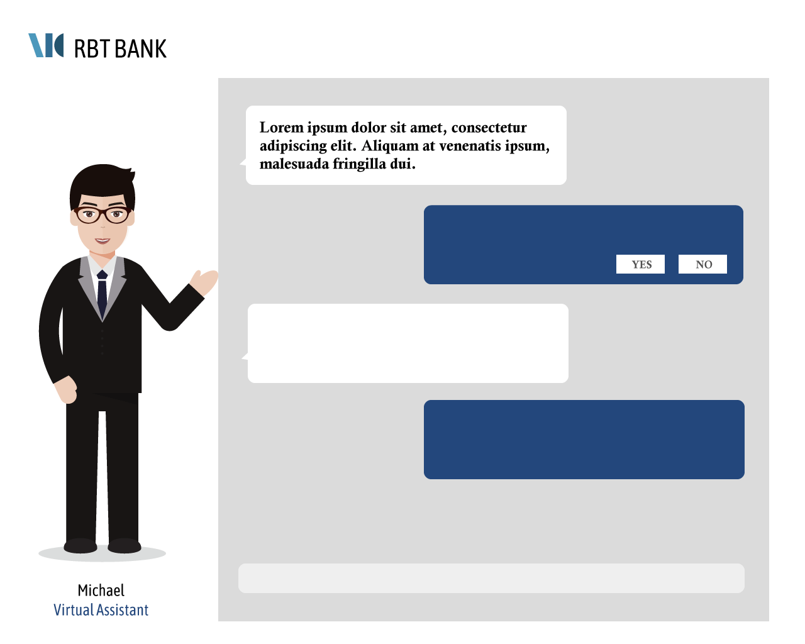
Mock-ups for Studies 1 & 2
Mock-up of introduction page
Mock-up of chatting page
Mock-up of survey page (after each task)
Introduction
Meet your conversational virtual assistant, Zan/Michelle/Michael.
Zan/Michelle/Michael is a conversational personal finance assistant who can help you with basic tasks, for example setting up a bank account. Using the information that you provide, Zan/Michelle/Michael is able to compute the best recommendation just for you. Zan/Michelle/Michael is designed by the Customer Experience and Tech team at RBT bank, who have 8 combined years of customer experience and 9 combined years of computer programming experience.
Today, you will go through a demonstration session where Zan/Michelle/Michael will help you with three simple personal finance tasks:
1. Choosing a bank savings account
2. Choosing a home loan plan
3. Choosing a life insurance policy
[Click here to begin.]
Evaluation of Experience
Mock-up of survey page (continued)
Evaluation of Experience

Slide 5
Mock-ups for Online Pilot Study
Mock-up of introduction page
Mock-up of chatting page
Mock-up of survey page (after each task)
Introduction
Meet your conversational virtual assistant, Zan/Michelle/Michael.
Zan/Michelle/Michael is a conversational personal finance assistant who can help you with basic tasks, for example setting up a bank account. Using the information that you provide, Zan/Michelle/Michael is able to compute the best recommendation just for you. Zan/Michelle/Michael is designed by the Customer Experience and Tech team at RBT bank, who have 8 combined years of customer experience and 9 combined years of computer programming experience.
Today, you will go through a demonstration session where Zan/Michelle/Michael will help you with three simple personal finance tasks:
1. Choosing a bank savings account
2. Choosing a home loan plan
3. Choosing a life insurance policy
[Click here to begin.]
Evaluation of Experience
Mock-up of survey page (continued)
Evaluation of Experience

